Slide 1
PRESENTATION ON AI CHAT BOT WITH PYTHON
Presented By:
H.VARDHAN REDDY (210303125008)
B.ARAVIND KUMAR (210303124238)
B.SURESH REDDY (210303125029)
CH.MAHESH (210303125033)
Guided By:
Jeenal Patel
CSE Department
PIET, Parul University
Internal Project Presentation 2024

Slide 2
Content
Introduction
Background study (Research Paper Summary in Table form – Format shared in the next slide)
Objectives of the Project
  What is exactly to be done?
  Why is this project selected?
  Where is the project is helpful?
  When it can be implemented?
  Who will be benefitted?
Project Team : Roles and Responsibilities
Schedule
UML Diagrams
Advantages of the System
Limitations of the System
Conclusion
Future Work
References
Project Presentation 2024

Slide 3
INRODUCTION
Project Definition
Chatbots can provide real-time customer support and are therefore a valuable asset in many industries. When you understand the basics of the Chatter Bot library, you can build and train a self-learning chatbot with just a few lines of Python code.
Project Aim
. The aim of an AI chatbot with Python is to create a program that can understand and respond to user inputs in a conversational manner, with purposes ranging from customer service and task automation to entertainment and language practice.
Project Presentation 2024

Slide 4
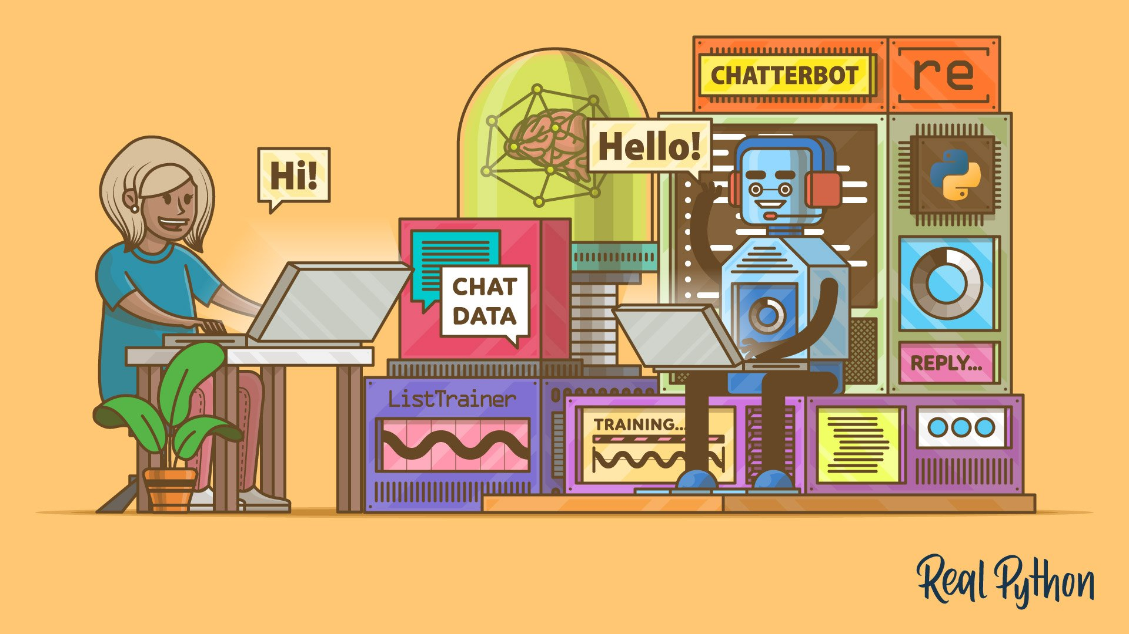
Project Presentation 2023

Slide 5
Research Papers studied
Sr. no | Paper Title | Publisher | Year | Take-away points
1. | "A Survey on Chatbot Implementation in Customer Service Industry using Python" | L. L. R. Prasath, A. Madan, and A. K. Bhuvaneswari | 2018 | It reviews deep learning techniques for facial expression recognition, highlighting the advancements, challenges, and potential future directions in the field.
2. | "Building Chatbots in Python" | S. Maity, S. Chakraborty, and S. Jana | 2019 | This provides an extensive review of sentiment analysis methodologies in the context of deep learning, covering various techniques, datasets, and challenges.
3. | "Deep Reinforcement Learning-Based Chatbot for Customer Service | : A. Mollahosseini, D. Chan, and M. H. Mahoor | 2016 | The research introduces a real-time facial expression recognition system based on Convolutional Neural Networks (CNNs), achieving high accuracy in different conditions.
4. | "Seq2Seq Chatbot Models for Conversational Understanding: A Survey" | A. Gandomi and M. Haider | 2019 | This survey provides a comprehensive overview of sentiment analysis and opinion mining, covering techniques, offering insights into the evolving landscape of sentiment analysis research.

Slide 6
Objectives of the Project
Chatbots allow businesses to connect with customers in a personal way without the expense of human representatives.
For example, many of the questions or issues customers have are common and easily answered. That's why companies create FAQs and troubleshooting guides.
The main objective is to reduce the burden on the college faculties by deferring the responsibility of answering the visitors' doubts regarding the college to the chatbot by creating a web-based chatbot that can be incorporated with the college website and can answer the users' text as well as audio-based queries.
Project Presentation 2024

Slide 7
Project Team : Roles and Responsibilities
Sr. no | Team member | Enrollment number | Role | Responsibility
1. | H.Vardhan Reddy | 210303125008 | Data preparation | , Collect, Clean, and Preprocess Data, Optimize
2. | B.Aravind Kumar | 210303124238 | ML, Flask, React/Vue.js | Develop AI Models Design and infrastructure for web applications, ensuring efficiently
3. | B.Suresh Reddy | 210303125029 | NLP, TensorFlow/PyTorch, Keras | Create intuitive and engaging user interfaces for web applications using modern frontend technologies and frameworks.
4. | CH. Mahesh | 210304125033 | Computer Vision, MongoDB/PostgreSQL | Develop and manage Data computer vision.
Project Presentation 2024

Slide 8
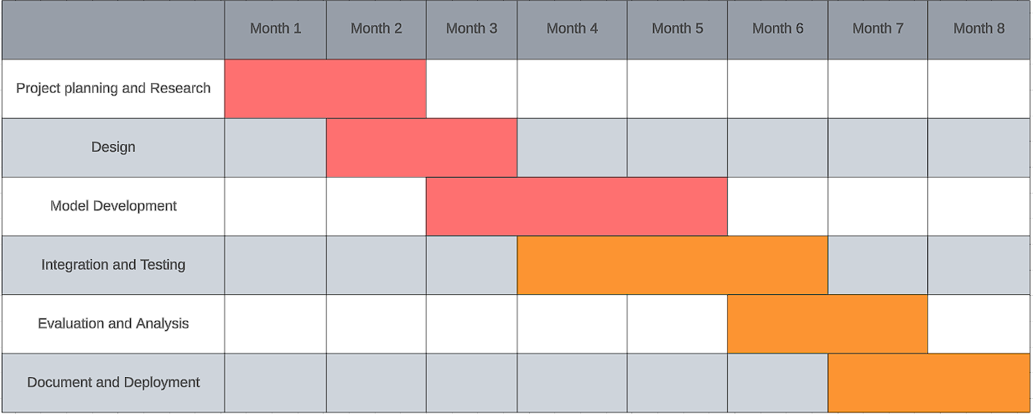
Time Line Chart - Schedule
Project Presentation 2024

Slide 9
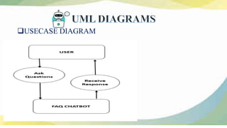
Project Presentation 2024

Slide 10
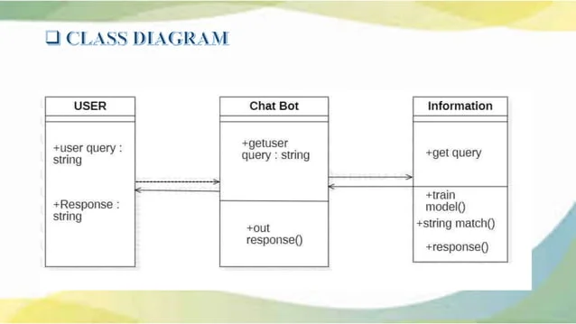
Project Presentation 2023

Slide 11
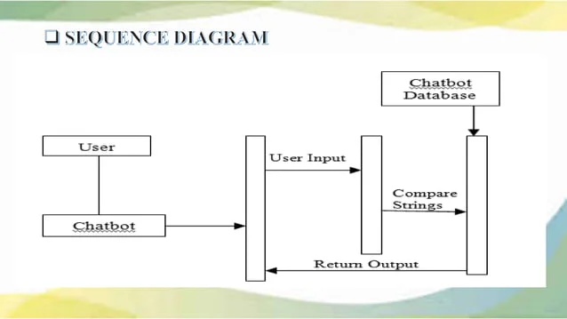
Project Presentation 2023

Slide 12
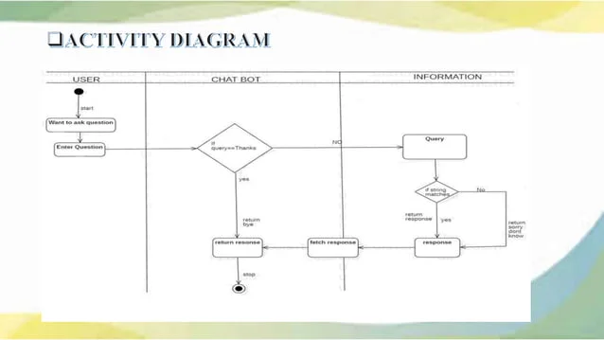
Project Presentation 2023

Slide 13
Advantages of the System
Flexibility and Scalability: python is a highly versatile language with extensive libraries and frameworks for ai and natural language processing (nlp), making it easy to adapt and scale the chatbot system as needed.
Rich Ecosystem: python has a vast ecosystem of open-source tools and libraries, such as tensorflow, pytorch, nltk, spacey, and scikit-learn, which facilitate the development of advanced ai chatbot functionalities.
Ease of Development: python's simple and readable syntax, along with its extensive documentation and community support, makes it accessible for developers of varying skill levels to build and maintain ai chatbots efficiently.
Project Presentation 2023

Slide 14
Integration Capabilities: python seamlessly integrates with various apis, databases, and web services, allowing developers to incorporate external data sources and functionalities into the chatbot system, enhancing its capabilities and usefulness.
Rapid Prototyping: python's dynamic typing and interpreted nature enable rapid prototyping and experimentation, enabling developers to quickly iterate on chatbot features and test different algorithms and approaches.
Machine Learning Capabilities: python is the language of choice for many machine learning tasks, including training and deploying ai models for natural language understanding and generation, enabling chatbots to provide more personalized and context-aware responses.
Community Support: python has a large and active developer community, with abundant resources, forums, and online tutorials available to assist developers in overcoming challenges and optimizing their ai chatbot implementations.
Project Presentation 2023

Slide 15
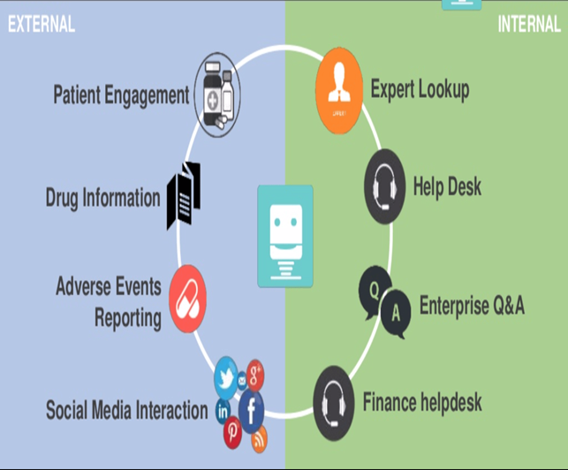
Project Presentation 2023

Slide 16
Limitations of the System
Performance: python is an interpreted language, which can lead to slower performance compared to compiled languages like c++ or java. this can be a concern for chatbots requiring high throughput or real-time responses, especially when dealing with large datasets or complex models.
Resource Intensive: some python libraries and frameworks for ai and nlp, such as tensorflow and spacy, can be resource-intensive, requiring substantial computational power and memory. this can limit the scalability of ai chatbots deployed on resource-constrained environments.
GIL (Global Interpreter Lock): python's gil can impact multi-threaded performance, particularly in cpu-bound tasks, as only one thread can execute python bytecode at a time. this limitation can affect the scalability of ai chatbots relying on multi-threading for concurrent processing.
Project Presentation 2023

Slide 17
Difficulty in Deployment: python's dependency management and packaging can be challenging, especially when deploying ai chatbots to production environments with specific dependencies or runtime requirements. ensuring consistency across different deployment environments may require additional effort.
Limited Mobile Support: while python can be used for mobile app development using frameworks like kiv or beware, native mobile support is limited compared to languages like swift (for ios) or kotlin (for android). this can restrict the deployment options for ai chatbots targeting mobile platforms.
Community Support for Specific Domains: while python has a rich ecosystem for general-purpose ai and NLP tasks, community support and pre-trained models may be limited for specific domains or languages. developing custom solutions or fine-tuning existing models may require additional expertise and effort.
Project Presentation 2023

Slide 18
Conclusion
In conclusion, developing AI chatbots using Python offers numerous advantages, including flexibility, scalability, rich ecosystem, ease of development, and extensive community support. Python's versatility and simplicity make it an ideal choice for implementing various AI and natural language processing (NLP) functionalities, enabling developers to build sophisticated conversational agents tailored to specific use cases and domains.
However, it's important to acknowledge the limitations of Python in AI chatbot development, such as performance concerns, resource intensiveness, deployment challenges, and limitations in mobile support. Addressing these limitations requires careful consideration of architectural decisions, optimization strategies, and adherence to best practices in software engineering and AI development.
Project Presentation 2023

Slide 19
Future Work
Future work in AI chatbot development using Python could focus on several areas to further enhance the capabilities, performance, and user experience of chatbot systems. Some potential directions for future research and development include:
Improving Natural Language Understanding (NLU): Enhancing the chatbot's ability to accurately understand and interpret user inputs through advanced NLP techniques such as contextual understanding, sentiment analysis, and entity recognition. This could involve exploring more sophisticated machine learning models, pre-training on large text corpora, or leveraging domain-specific knowledge bases.
Project Presentation 2023

Slide 20
Personalization and Context Awareness: Making chatbots more personalized and context-aware by leveraging user data, preferences, and interaction history. This could involve integrating recommendation systems, user profiling techniques, and contextual memory mechanisms to tailor responses and interactions to individual users' needs and preferences.
Multi-turn Dialogue Management: Improving the chatbot's ability to engage in multi-turn conversations and maintain coherence and context across dialogue sessions. This could involve developing more sophisticated dialogue management systems based on reinforcement learning, hierarchical modeling, or memory-augmented architectures.
Project Presentation 2023

Slide 21
References
Books:
"Natural Language Processing with Python" by Steven Bird, Ewan Klein, and Edward Loper.
"Python Deep Learning" by Ivan Vasilev and Daniel Slater.
"Deep Learning for Natural Language Processing" by Palash Goyal, Sumit Pandey, and Karan Jain.
Online Courses:
Coursera: "Natural Language Processing" by National Research University Higher School of Economics.
Udemy: "Build Your Own First Person Shooter / Survival Game in Unity" by Nick Lalone.
edX: "Deep Learning with Python and PyTorch" by IBM.
Project Presentation 2023

Slide 22
Research Papers:
"Attention is All You Need" by Ashish Vaswani et al., introducing the Transformer architecture, which has been influential in NLP tasks including chatbots.
"BERT: Pre-training of Deep Bidirectional Transformers for Language Understanding" by Jacob Devlin et al., presenting the BERT model, which has achieved state-of-the-art results in various NLP tasks.
"BERT-based Conversational AI" by Jacob Devlin, Ming-Wei Chang, Kenton Lee, and Kristina Toutanova, discussing the application of BERT in building conversational AI systems.
Project Presentation 2023

Slide 23
Thank you
Project Presentation 2023

